Slide 1
Crud-mvc application
Doketov alexander

Slide 2
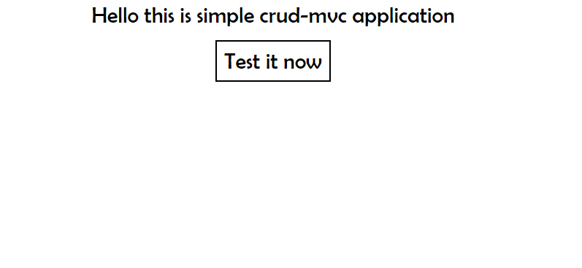
WELCOME PAGE

Slide 3
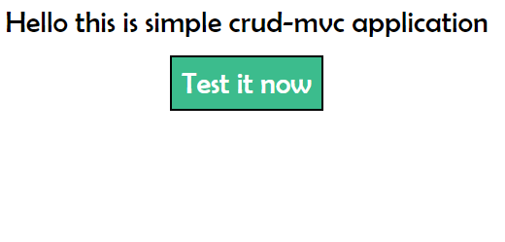
WELCOME PAGE HOVER

Slide 4
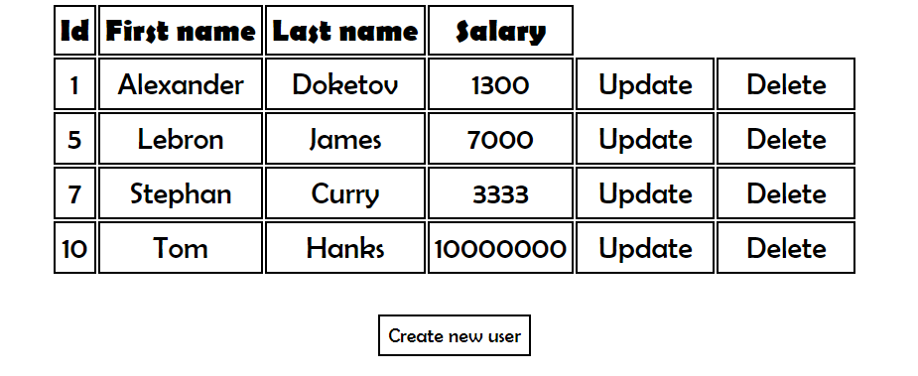
ALL USERS LIST

Slide 5
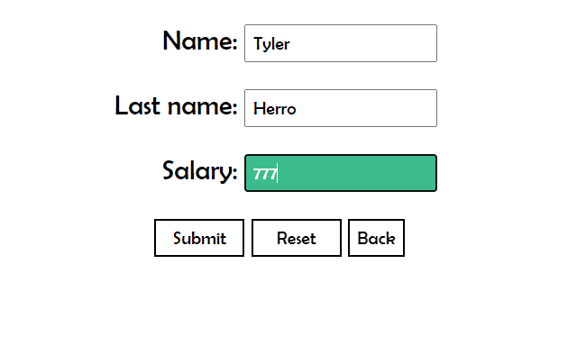
ADDITION OF USER PAGE

Slide 6
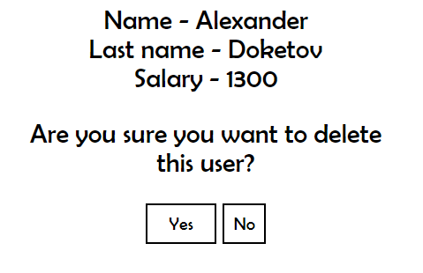
CONFIRMATION OF DELETING PAGE

Slide 7
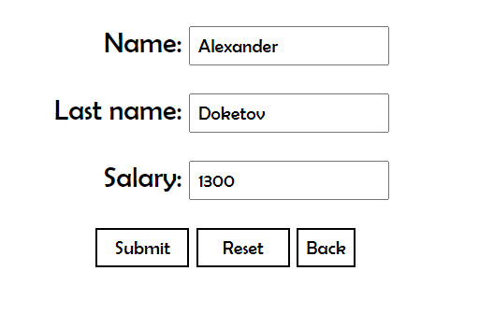
UPDATING PAGE

